Slide 1
VIETNAMESE BUDDHISTS’ PARTICIPATION IN ENVIRONMENT PROTECTION AND RESPONSE TO CLIMATE CHANGE
By: Vu Trung Kien- Climate.vn

Slide 2
THE HOLISTIC APPROACH TO ENVIRONMENTAL ISSUES
Climate change & Environment issues
Measures/Tools
( Scientists & enterprises)
Methods/Mechanisms
(Policy makers)
Meaning/Cause for actions
(Environmental ethics)

Slide 3
ENVIRONMENTAL SOLUTIONS through RELIGIONS
Religion’s norms & values
Followers’ behaviors and beliefs
Voluntary behaviors to tackle environmental problems

Slide 4
4 MORAL STANDARDS OF BUDDHISM
Inter-dependence of all beings
Respect for life and living creatures
Moderation, harmony with nature
Simple livelihood, restraining greed.
GREEN LIVING ETHIC

Slide 5
BUDDHISM & CLIMATE CHANGE RESILIENCE
→ The 4 moral standards make Buddhism a very suitable religion to convey the green/ environment messages.

Slide 6
VIETNAMESE BUDDHISTS’ PARTICIPATION IN ENVIRONMENT PROTECTION
Activities/ events
Trainings/ Seminars

Slide 7
ACTIVITIES/ PROGRAMS IN VIETNAM
Environment clean-up campaign, in the world environment day - Tay Thien Phu Nghi pagoda-Vinh Phuc, Viet Nam (2013)
Delivered message: Think- Eat- Save
Participation: 200 Buddhists and 500 volunteer students.

Slide 8
ACTIVITIES/ PROGRAMS IN VIETNAM

Slide 9
ACTIVITIES/ PROGRAMS IN VIETNAM
2. Street march : Buddhism with environment
( National Hoang phap seminar ) in Binh Duong, Viet Nam, March 2011
Delivered the message: “ Jointly keep the environment green, clean and beautiful for a peaceful and happy world”
1500 Buddhists participated

Slide 10
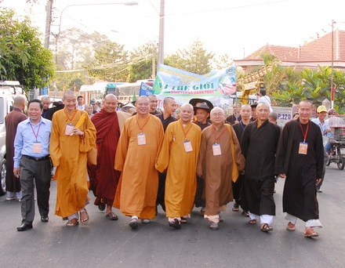
Chu Ton Duc & Buddhists family join march
ACTIVITIES/ PROGRAMS IN VIETNAM

Slide 11
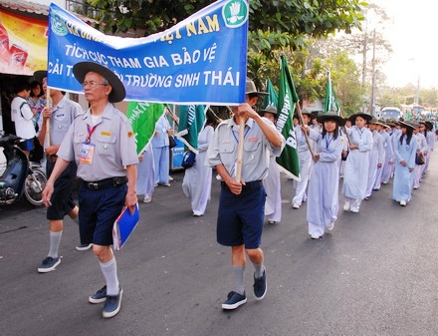
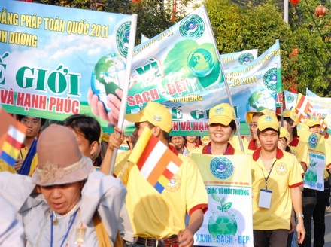
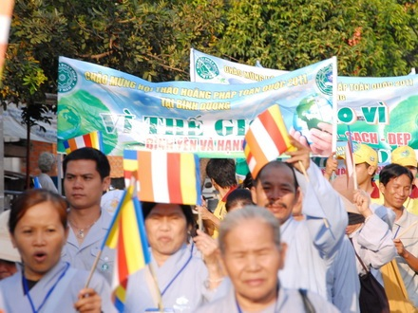

Slide 12
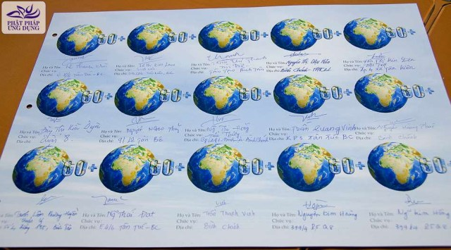
ACTIVITIES/ PROGRAMS
3. Earth hour 2013: Signed convention to protect the environment ( March 2013)
Collect 5000 signatures in the environment protection convention
Places: Giac Ngo pagoda, Tu Van pagoda, Thien Chanh pagoda and the Young Buddhist club

Slide 13
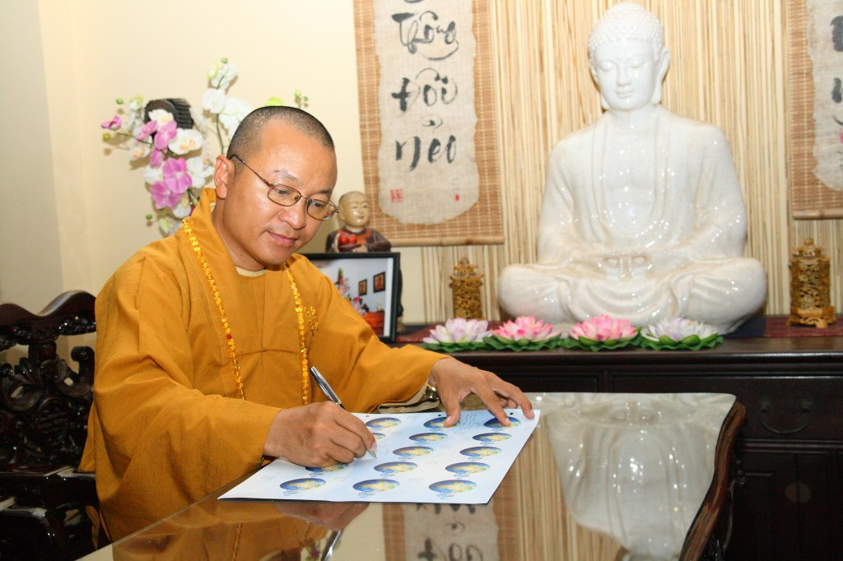
HH. Thich Nhat Tu – President of cultural committee, Ho Chi Minh buddhist sangha signed the convention
ACTIVITIES/ PROGRAMS IN VIETNAM

Slide 14
ACTIVITIES/ PROGRAMS IN VIETNAM

Slide 15
ACTIVITIES/ PROGRAMS IN VIETNAM
4. Contest: Study climate change in Tu Van pagoda ( November 24th 2013)
Research on climate change issues and environment protection- restriction of plastic bags.
Many Buddhists and scientists took part in the contest.

Slide 16
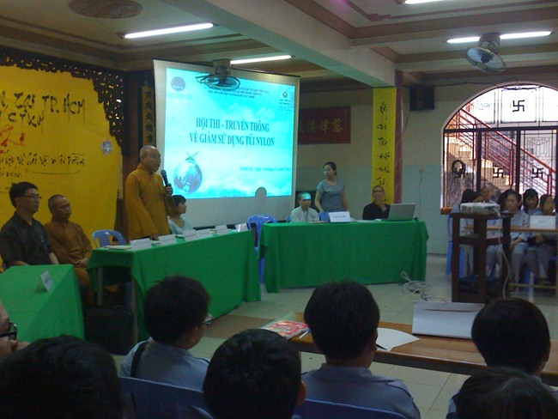
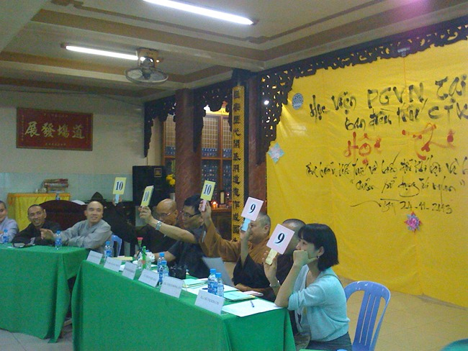
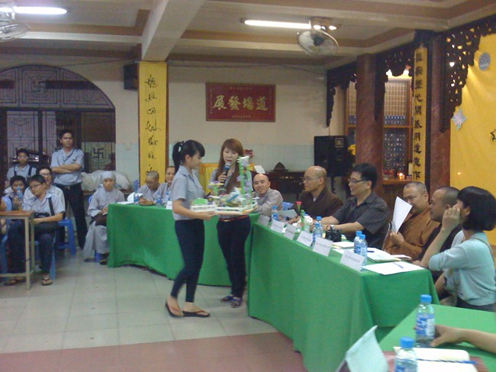
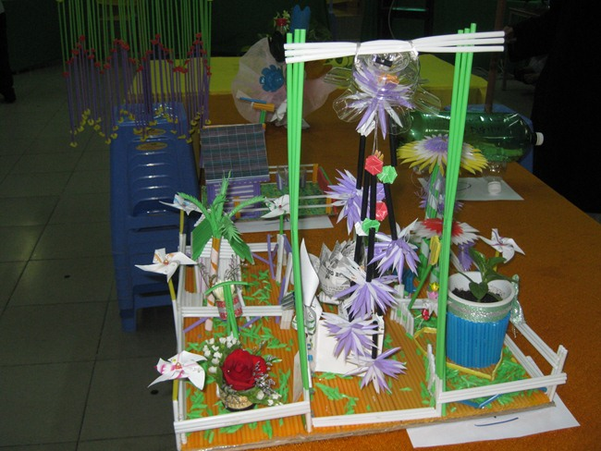

Slide 17
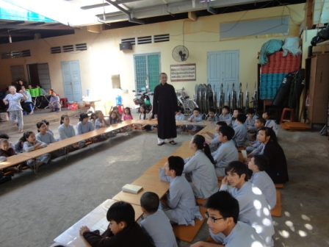
TRAINING/SEMINARS
Place: Thien Chanh pagoda, November 10th 2013
Provided knowledge on climate change: Causes, effects and resolutions.
Learners: Children
Trainers: Scientists and experts on climate change

Slide 18
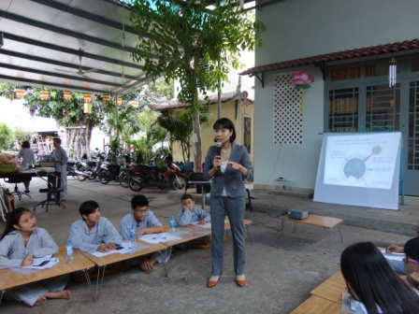
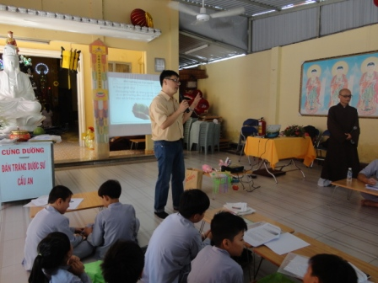
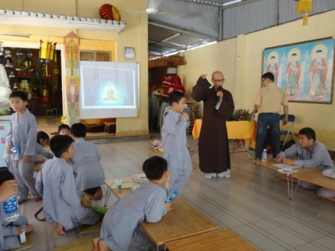

Slide 19
FINDINGS
Vietnamese Buddhists have been participating actively in environmental programs, especially if led by the Pagodas and local Government.
The environmental activities communicated via Internet could easily reach a large population of young Buddhists
Many young Buddhists take part in the activities. They prefer acting and self-experiencing to serious religious teachings.
Some activities were not efficient enough, still.
The call for action: Not always clear, especially regarding the correlation between human and climate change.

Slide 20
CONCLUSION AND RECOMMENDATIONS
Vietnamese Buddhists have actively participated in small and medium scale campaigns.
Many of those activities were not very well-communicated, and some have utilize Internet or social networks to create positive social impact to the local communities
Vietnamese Buddhists need to cooperate with international Buddhism’s programs in environment protection and climate change response.

Slide 21
CONCLUSION AND RECOMMENDATIONS
It is necessary to organize specific Green Living programs which closely relates to Buddhism’s spiritual teachings.
The Buddhists activities should always be in line with other solutions like policies, technologies, international cooperation…
Such programs should be put in Vietnam’s legal, economical, social, cultural circumstance, in international and regional conditions, coping with the development trends in solving the climate change problems.
There should be more creative solutions to encourage Buddhists and people acting together for better environment.

Slide 22
Q & A

